Slide 1

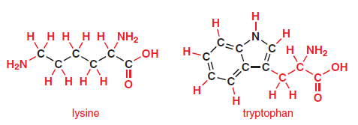


Slide 2



Slide 3
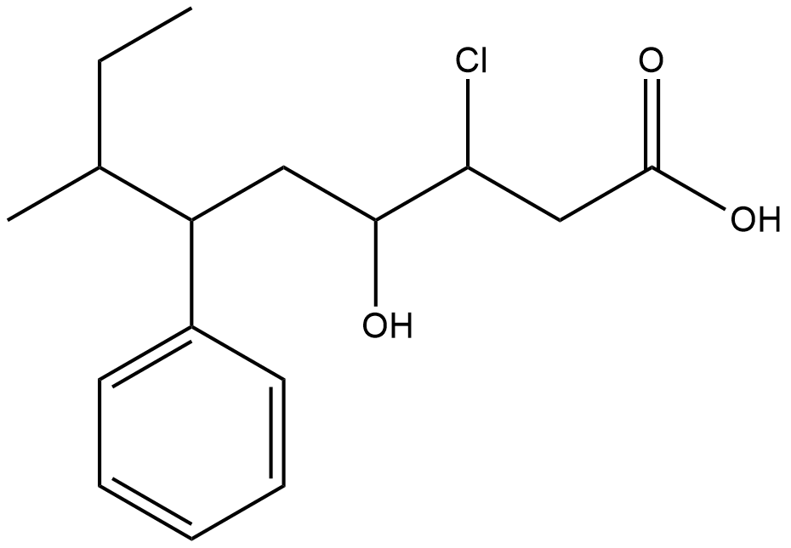
Substituents
Functional groups
Functional groups

